Slide 1

VARDHAMAN COLLEGE OF ENGINEERING, HYDERABAD
Autonomous institute affiliated to JNTUH
DEPARTMENT OF COMPUTER SCIENCE & ENGINEERING
Title: Student Loyalty And Reward Management System
BATCH ID : 17CSPW-C4
S. No | Roll. No | Student Name
1 | 17881A05C1 | Akkem Abhinav Yadav
2 | 17881A05D5 | Deepak Singh Thakur
3 | 17881A05E7 | Cheripalli Namrath
Guide Details
Sowmya Dudyala
Assistant Professor
Department of CSE

Slide 2
Major Project Review-2 Outlines
Main idea of the Project
Existing System Vs Proposed
Proposed Project Objectives
Proposed Project Outcomes
Software and Hardware Requirements
Process Model
Design Phase
Output Screens
Conclusion
Future Scope
References
DEPARTMENT OF CSE MAJOR PROJECT REVIEW-2

Slide 3
Main idea of the Project
This application focuses on reward system.
The System generated tokens are used as reward points which are generated by the concept of Token generation in Cryptocurrency and which are managed by the Blockchain.
Tokens are awarded to the students as they progress through the defined milestones by the faculty . And as a reward, When a student Wins any competition or contest
These reward points can be used to conduct transactions. i.e.; to enroll the digital courses or use for paying the library dues.
DEPARTMENT OF CSE MAJOR PROJECT REVIEW-2

Slide 4
Existing System Vs Proposed
Existing rewarding system allows users to redeem the reward with in the specific organization.
The current student reward system comprises of trophies, certificates(handheld), coupons, loyalty points which does not hold any value
Proposed system generates the tokens that holds economical value. So, these tokens can be redeemed in exchange of services or products.
these tokens enables freedom to students to choose and utilize on something that truly holds value to oneself.
This even encourages students to participate in activities in pursuit of these tokens.
DEPARTMENT OF CSE major PROJECT REVIEW-2

Slide 5
Proposed Project Objectives
Token generation system:
It is implemented upon the Ethereum network (ERC-20).
These generated tokens could be used as the currency as they hold economical value.
Security Management System:
It ensures all the transactions to be consistent And provides security to all the user data.
It enables the user to get connected to the secured transaction tunnel during, making any kind of transaction .
User management system:
It manages all the user data and profiles and user authentication system.
Account recovery system.
Wallet:
It holds all the received rewards and generated tokens.(External Accounts)
DEPARTMENT OF CSE MINI PROJECT REVIEW-1

Slide 6
Proposed Project Outcomes
Tokens are generated by ERC-20 are awarded as students progress through their assignments
It inherits the properties of web3. where all the transactions are anonymous and uses the decentralized applications.
Better security and privacy of transactions because of block-chain.
efficient transactions compared to legacy banking with 100% efficiency.
Easy to manage and create.
DEPARTMENT OF CSE MAJOR PROJECT REVIEW-2

Slide 7
Software and Hardware Requirements
Software Requirements:
Ethereum network
ERC-20 (token generator)
Web3.js package to communicate with the remote Ethereum node
Django framework
Solidity(creating smart contract )
Sql-lite database
Rest framework (to handle the api requests)
Ganache for local test network implementation
Infura (bridge server between the web wallet and the metamask wallet)
Metamask (is the external wallet to handle the transactions )
Hardware Requirements:
Pc with RAM>4GB and windows 7/8/9/10 or mac os or ubuntu.
Mobile phone or Desktop
DEPARTMENT OF CSE MAJOR PROJECT REVIEW-2

Slide 8
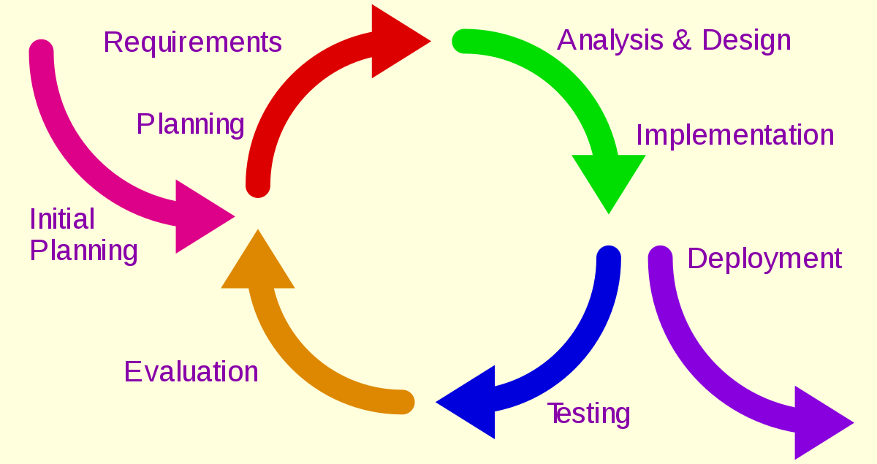
Process Model
ITERATIVE PROCESS MODEL
DEPARTMENT OF CSE MAJOR PROJECT REVIEW-2

Slide 9
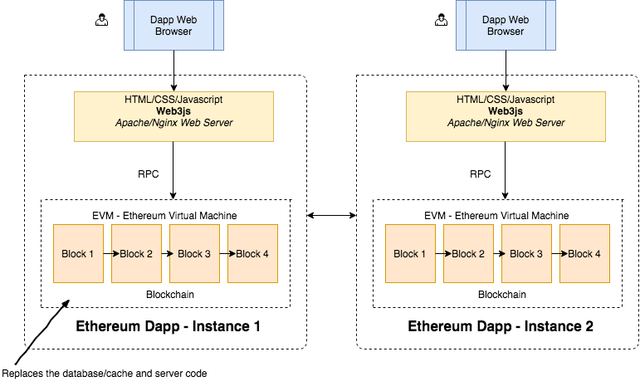
Architectural Diagram
.
DEPARTMENT OF CSE MAJOR PROJECT REVIEW-2

Slide 10
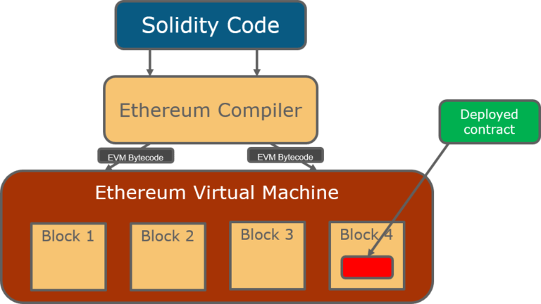
Architectural Diagram
DEPARTMENT OF CSE MAJOR PROJECT REVIEW-2

Slide 11

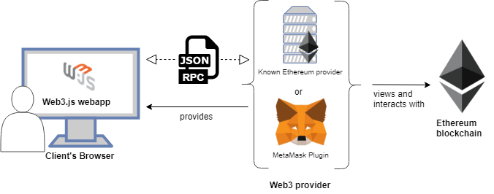
Design Phase : PROCESS FLOW
DEPARTMENT OF CSE MAJOR PROJECT REVIEW-2

Slide 12
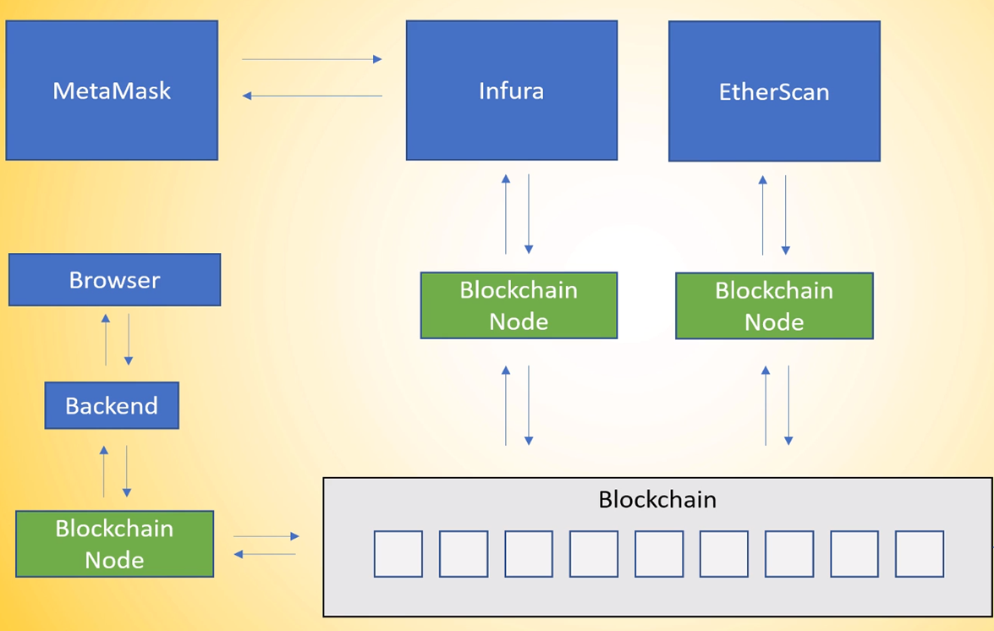
Design Phase : PROCESS FLOW
DEPARTMENT OF CSE MAJOR PROJECT REVIEW-2

Slide 13
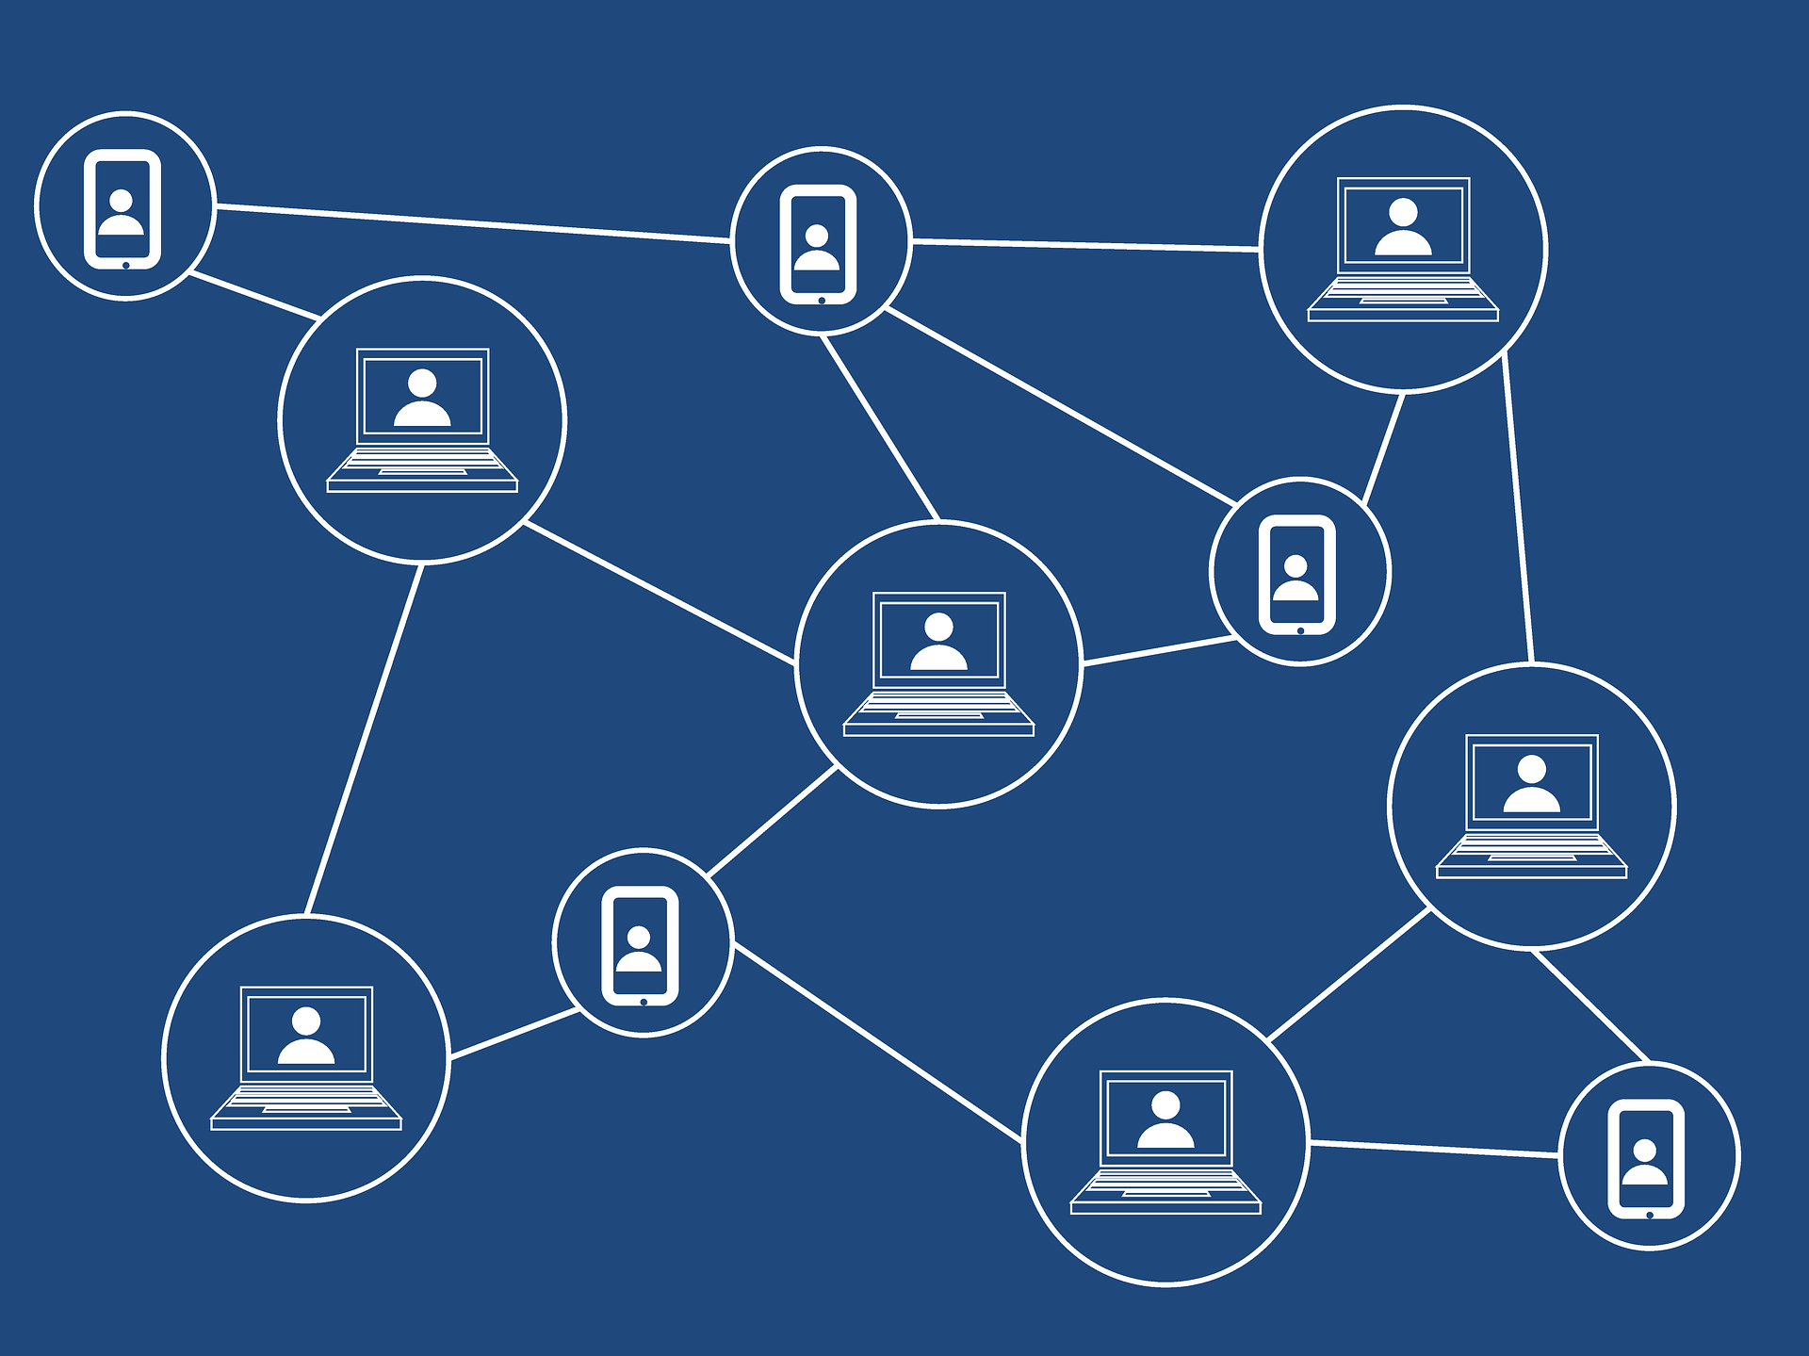
Deployment Diagram
DEPARTMENT OF CSE MAJOR PROJECT REVIEW-2

Slide 14
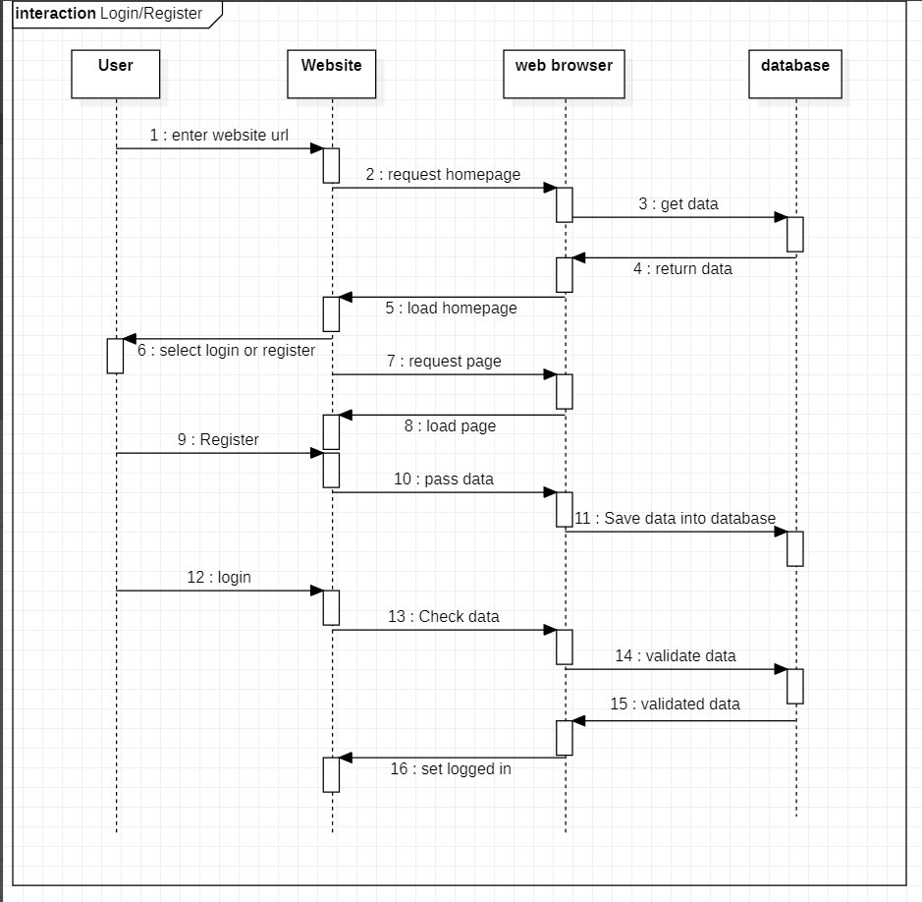
Design Phase : Sequence Diagram
DEPARTMENT OF CSE MAJOR PROJECT REVIEW-2

Slide 15
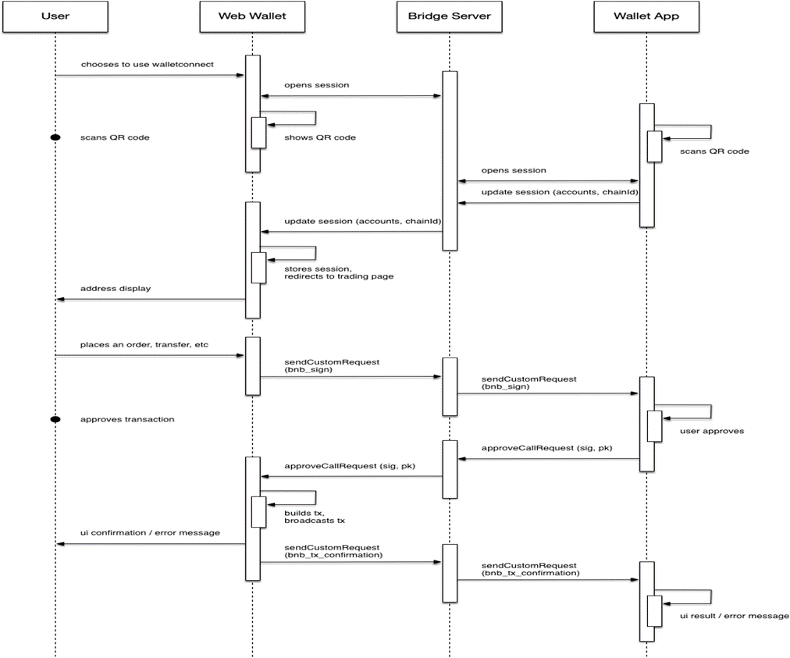
Design Phase : Sequence Diagram
DEPARTMENT OF CSE MAJOR PROJECT REVIEW-2

Slide 16
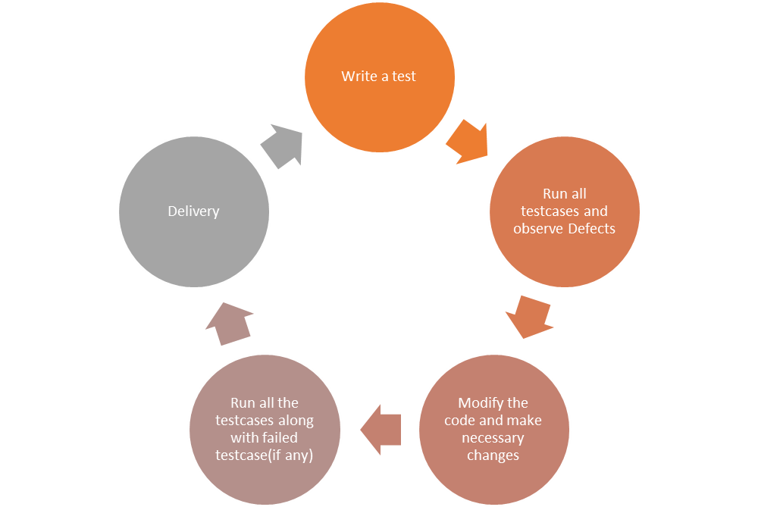
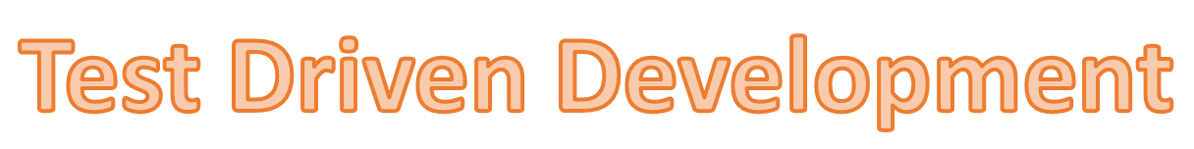
Testing Strategy
DEPARTMENT OF CSE MAJOR PROJECT REVIEW-2

Slide 17
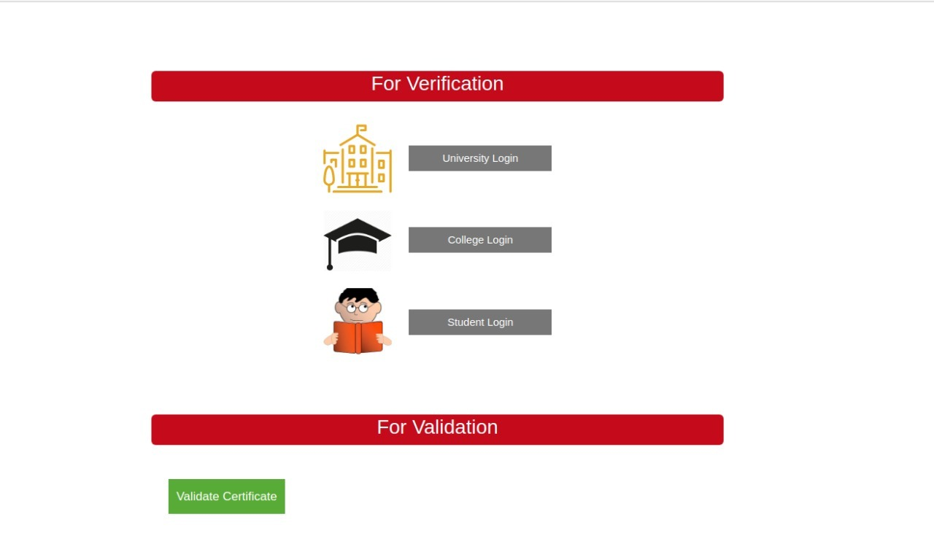
Outputs
DEPARTMENT OF CSE MAJOR PROJECT REVIEW-2

Slide 18
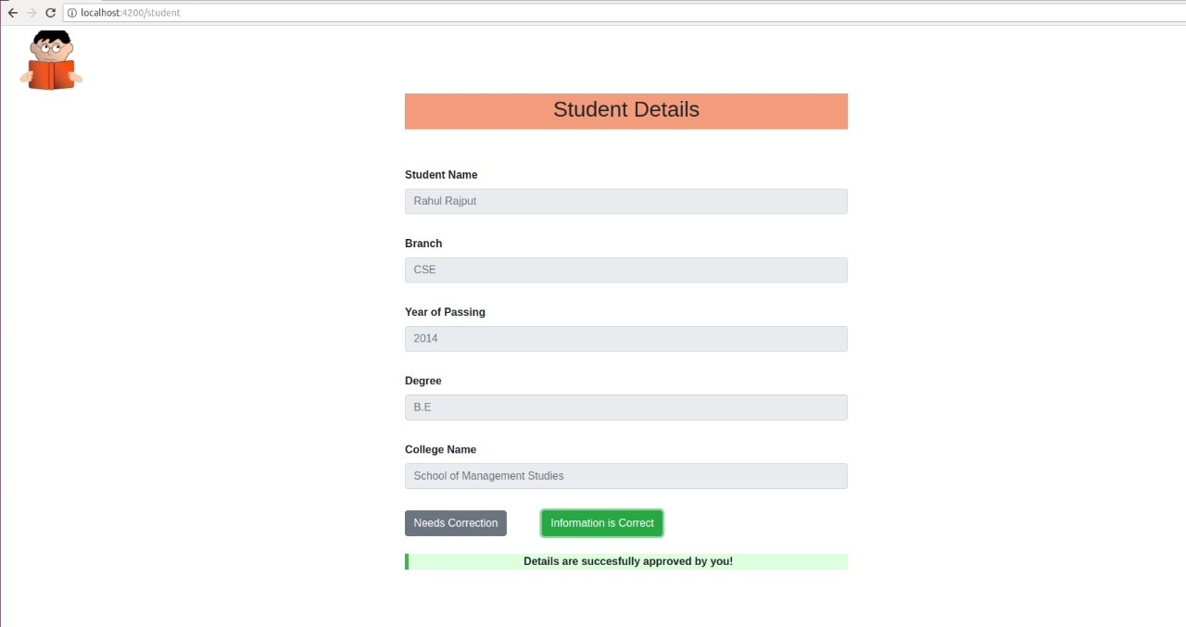
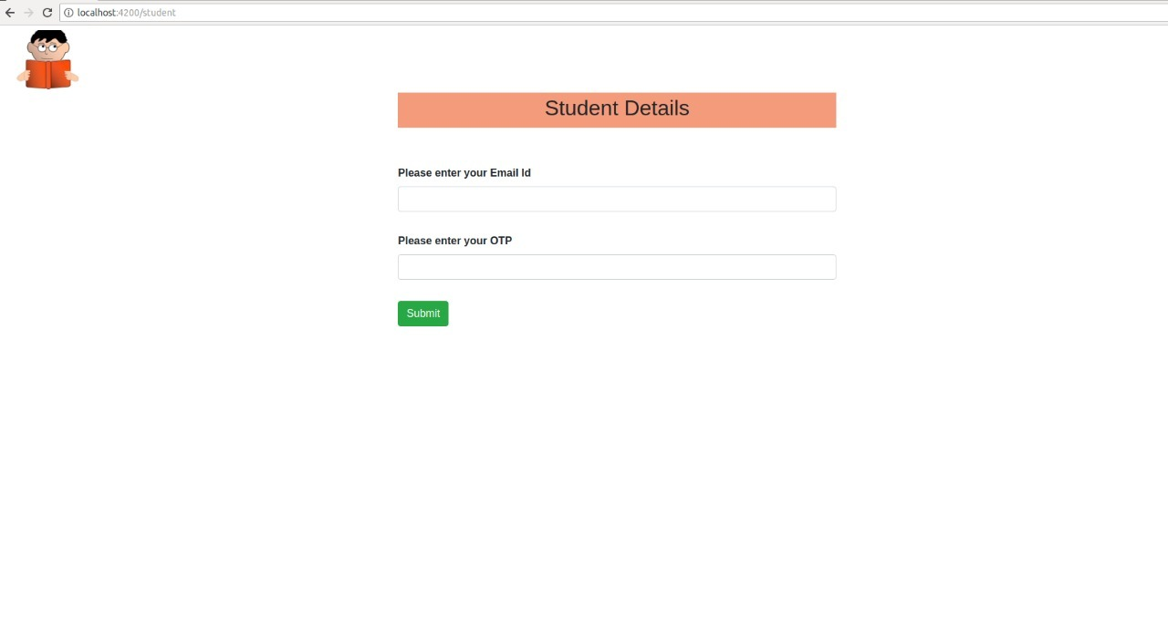
Outputs
DEPARTMENT OF CSE MAJOR PROJECT REVIEW-2

Slide 19
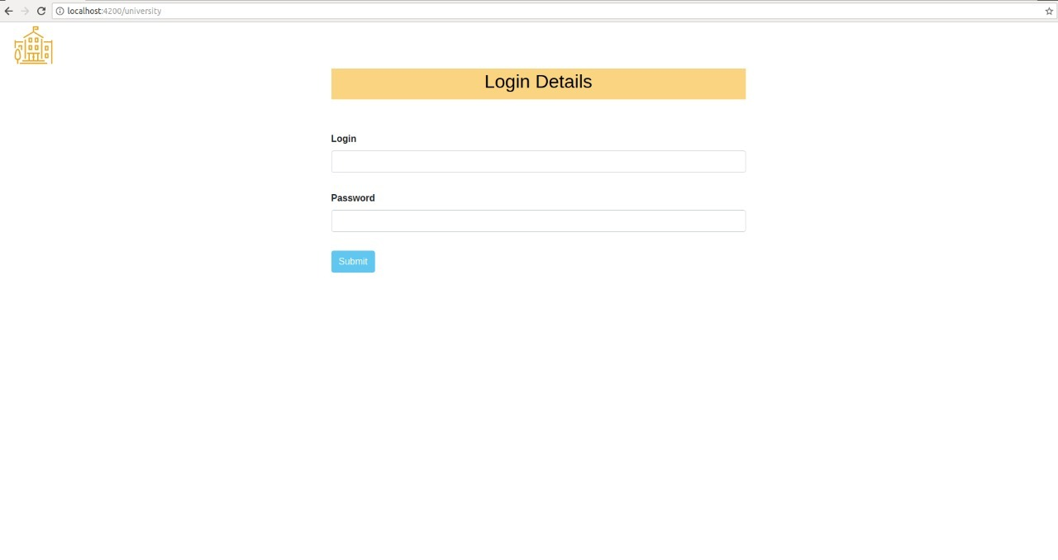
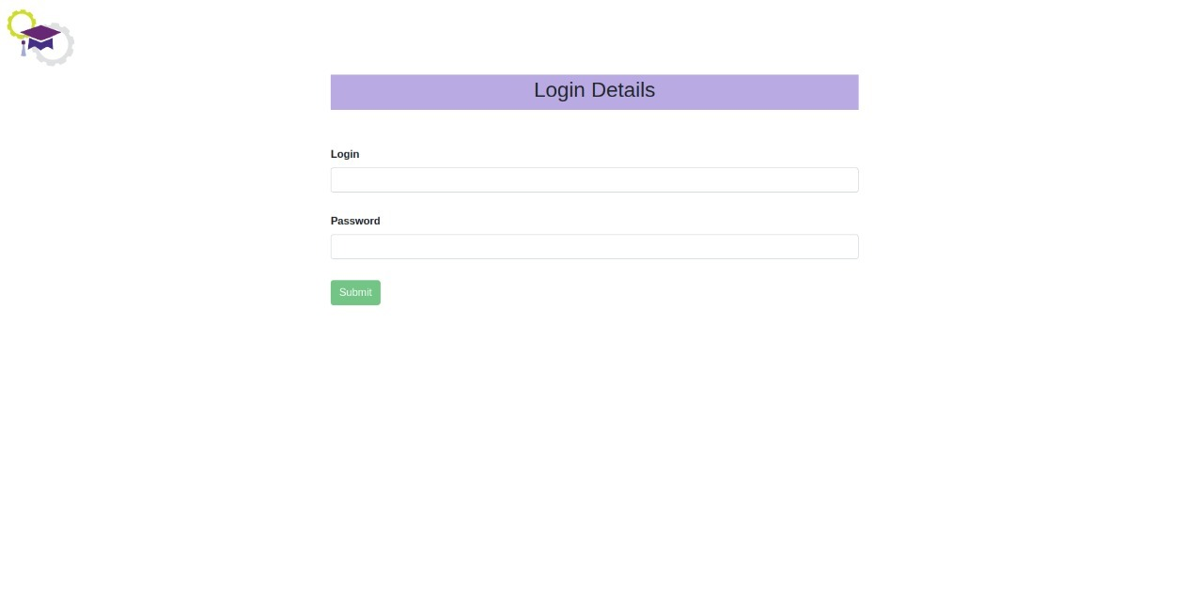
Outputs
DEPARTMENT OF CSE MAJOR PROJECT REVIEW-2

Slide 20
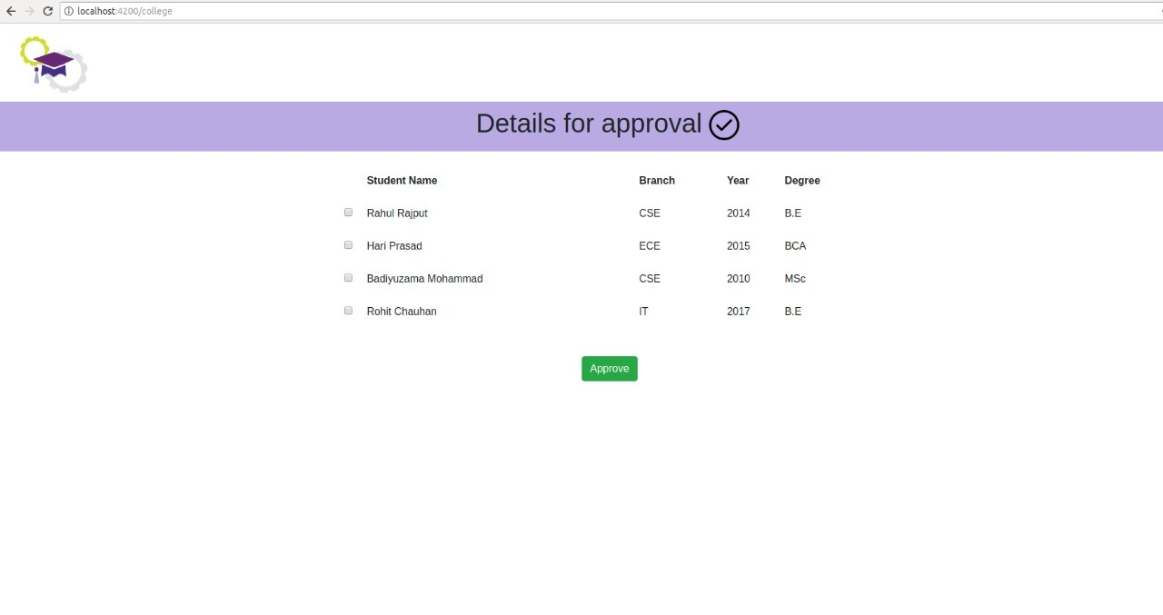
Outputs
DEPARTMENT OF CSE MAJOR PROJECT REVIEW-2

Slide 21
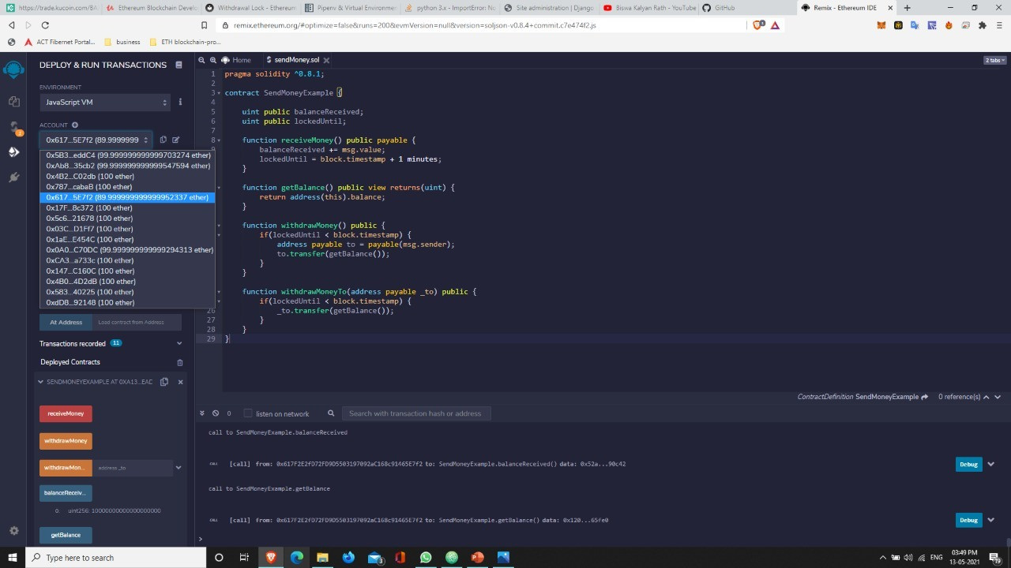
Outputs
DEPARTMENT OF CSE MAJOR PROJECT REVIEW-2

Slide 22
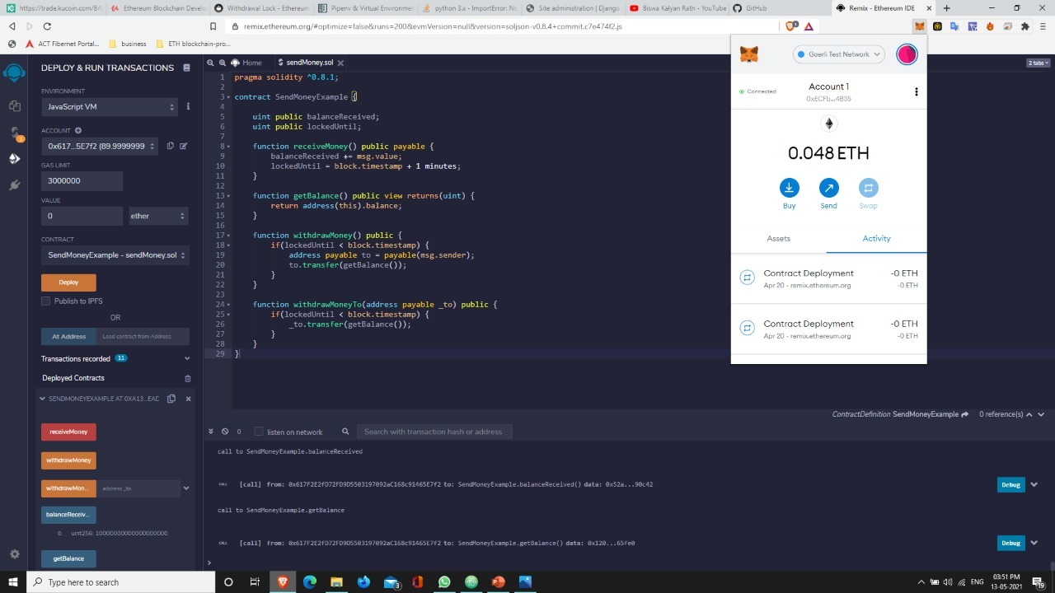
Outputs
DEPARTMENT OF CSE MAJOR PROJECT REVIEW-2

Slide 23
Conclusion
This application is used by faculty and students. Faculty defines a milestones by which tokens or rewards are awarded to the students.
And these tokens can be redeemed for enrolling the digital course (from third party) or paying dues in the library
DEPARTMENT OF CSE MAJOR PROJECT REVIEW-2

Slide 24
Future Scope
Can be integrated with the existing e-learning portal of the college.
2. It can be used in day to day commercial transactions.
3. Even develop the NFT registration for the projects to retain the ownership
4. Even use NTF’s for the monetary exchanges
DEPARTMENT OF CSE MAJOR PROJECT REVIEW-2

Slide 25
References
[1] “Mastering Tokens: Unlocking digital cryptocurrencies”, Textbook by Andreas M. Antonopoulos.
[2] IEEE research paper-2019 on How the blockchain enables and constrains supply chain performance.
[3] Research paper sample_The biblical metaphors in the novel “The Master and Margarita” by Mikhail Bulgakov
DEPARTMENT OF CSE MAJOR PROJECT REVIEW-2

Slide 26
Thank You
DEPARTMENT OF CSE MINI PROJECT REVIEW-1

